Slide 1
School of Nursing and Allied Health
Practice Assessor & Practice Supervisor
Transition/Update Session

Slide 2
Pleased to meet you….
Jan Darby
Lecturer in Diverse Placement Expansion
J.Darby@chi.ac.uk
01243 793497

Slide 3
SESSION AIMS
Overview of School of Nursing & Allied Health (SNAH) courses and future development
Review and refresh: roles of Practice Assessor (PA) and Practice Supervisor (PS) underpinned by NMC (2018) Standards for Student Supervision & Assessment (SSSA)
Relate to roles of supervision and assessment in the clinical environment

Slide 4
School of Nursing & Allied Health University of Chichester College Lane Chichester PO19 6PE
Dr Nita Muir – Head of School
Paul Watters – Bsc (Hons) Adult Nursing Programme Lead
Erika Thorne – Practice Placement/ PGDip Lead
Charlie Craig – Apprentice Nursing Associate Programme Lead
Est. 2021

Slide 5
Bsc (Hons) Adult Nursing Programme:-
Programme lead: Paul Watters
3 year course
50/50 theory v. practice
2 assessed placements per year (part)
8 weeks and 10-12 weeks practice placements
Optional non-assessed 2 weeks placement in Year (Part) 2
Current cohorts Sept 21 (Yr 3), Sept 22 (Yr 2), Sept 23 (Yr 1)

Slide 6
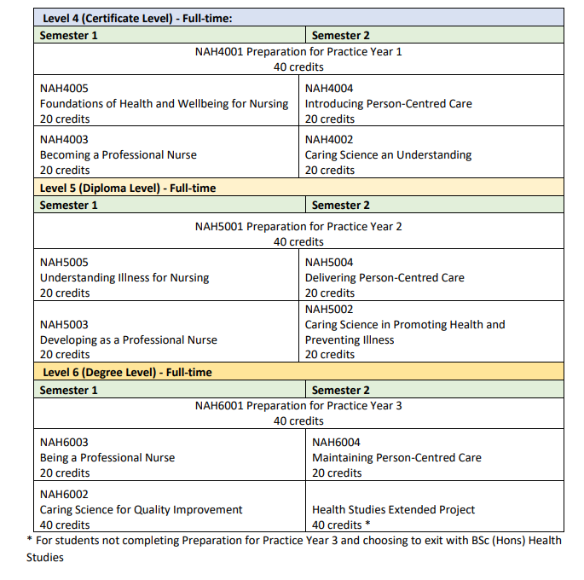
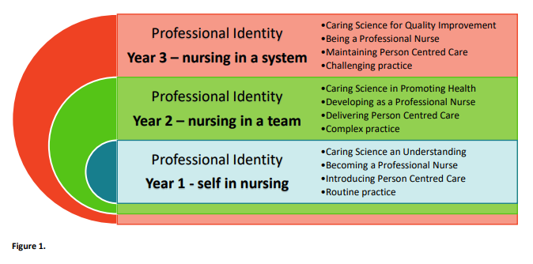

Slide 7
Post Graduate Diploma in Nursing (Adult)
Only PGDip Adult Nursing Course in Sussex
2 year accelerated programme
RPL 50% of Part 1 (Practice Learning and Academic Hours)
Course delivers remaining 50% Part 1 + All of Part 2 and Part 3 to meet the NMC hours for practice and academic learning
Blended Learning Course
1 day on campus – simulation/skills (Part 1 = 2 days)
Synchronous and asynchronous activity – MS Teams, Moodle VLE
Blocks of placement learning + placement experience day
Academic Block = 5 days of study per week
Placement Block = 37.5 hours per week of placement learning
Intensive course – independent study
Holiday built in to course – no option to take leave outside of this

Slide 8
Recognition of Prior Learning (RPL)
Applicants will also need to provide evidence of the following through an electronic portfolio (completed after being given a conditional offer)
Evidence of the equivalent of 600 hours (60 credits) of theoretical certified learning within the last 5 years
Map prior learning to the learning outcomes of Year 1 of the BSc (Hons) Adult Nursing programme
Provide evidence of a minimum of 262.5 hours of work experience (within the last 3 years ) in a professional caring role – verified by a Registrant (NMC/GMC/HCPC) or a Registered NVQ L5 manager
Reference from the verifier supporting your portfolio application

Slide 9
APPRENTICE NURSING ASSOCIATE (ANA) PROGRAMME
Programme Lead Charlie Craig
2 year Foundation Degree Programme in association with practice partners
First cohort commenced February 2023 – recruiting for Feb 24
Base placement – existing employment e.g. social care, acute Trust
4 external placements – 2 per year
Registration NMC – accountable practice ‘bridge between HCA/HSW & registered nurse’
Stand-alone role once successfully completed and registered – encouraging ‘grow your own workforce’, recognising and valuing staff

Slide 10
Professional Standards
NMC Standards for Student
Supervision &
Assessment (2018)
Practice Supervisor (PS)
Practice Assessor (PA)
Academic Assessor (AA)
Ensure safe & effective learning and uphold the safety of people
PS/PA/AA must have current knowledge & experience
Learner supervised by NMC registrant or any registered health professionals

Slide 11
PRACTICE ASSESSOR & PRACTICE SUPERVISOR
NMC (2018) Realising professionalism: Standards for education and training includes:-
Standards framework for nursing & midwifery education
Standards for student supervision & assessment (SSSA)
programme standards specific to each approved programme
PA/PS replaces the previous ‘mentor’ system

Slide 12
Practice Assessor (PA)
Must be a Registered Nurse
To assess and confirm the student’s achievement of practice learning & progression. Develops Action Plans as required
To enable/perform completion of summative aspects of PAD
One named Practice Assessor

Slide 13
PRACTICE ASSESSOR
1 PA per student will observe, conduct & record assessment, verify proficiencies/professional values through feedback from PS
Liaise with AA at relevant points
cannot act as both PA and PS for same student
can act as PA for one student and PS for another if required

Slide 14
Practice Supervisor (PS)
To supervise students in the practice learning environment – multiple Practice Supervisors
Can be any registered health care professional
Raise concerns to PA/AA
Contribute to assessments via feedback and completion of proficiencies
To make reasonable adjustments to support students

Slide 15
ACADEMIC ASSESSOR (AA)
based within SNAH all are NMC registrants
work in partnership with PA to evaluate and recommend student for progression for each part of education programme
supports individual students ensuring outcomes are reached in a timely manner
contact with student made at start, midpoint and end of placement
individual AA will contact their student’s PA at start of placement

Slide 16
Academic Assessor (AA)
Must be a Registered Nurse
Works collaboratively with the PS and PA to ensure support is available for all parties and to confirm progression of student with PA
Supports PA with completion of assessments, assists with action plans as required
Named AA – cannot be continuous

Slide 17
Student
Identifies learning needs and is pro-active in own learning
Collects evidence via feedback for PA to review
Open to feedback from a range of health professionals
Pro-active in organising summative assessments with PA
Shares any reasonable adjustments as able (RAWE)
Supernumerary but are hands on learners

Slide 18
LONG-ARM APPROACH TO SUPERVISION AND ASSESSMENT
SSSA (2018) Implementation of the long-arm model has re-established student opportunities – extending beyond the NHS
Private, independent and voluntary organisations (PIVOs)
Enables students to have more diverse experiences
Kate Knight et al (2022) The long-arm approach to placement supervision and assessment. British Journal of Nursing Vol 31, No 4

Slide 19
Learner Centred Approach
Shifts towards student
Teacher shifts from teller to designer
Responsibility for learning - student
Evaluation shifts to promoting learning

Slide 20
Peer Assisted Learning
Support
Coaching
COLLABORATIVE LEARNING in PRACTICE (CLiP)
Coach – registered staff member
Supervises Learning Bay led by students with HCAs as part of team
GROW model – learners identify objectives
Daily learning log
Students share experiences & knowledge
Support each other with learning
Actively encourages clinical decision making & delegation
Support for coach & learners from education team/PEFs

Slide 21
CREATING A CLINICAL LEARNING ENVIRONMENT
determine level of supervision required
contribute to assessment/provide appropriate feedback
meet learner requirements
facilitate independent learning

Slide 22
Placement preparation
Before Placement 1:
BLS & Manual Handling
HEE & Skills for Health (common skills e-learning)
Sessions – placement expectations, SSSA Standards, MyPad
Before Placement 3 & 5 (Years 2 & 3):
Session – introducing that year’s MyPad, expectations/goal setting
At the start and end of each Placement: Learning Circles
Prior to Placement:
Student makes contact – timeframe – arranges shifts
Receives a localised induction within first week

Slide 23
PLACEMENT ATTENDANCE
Student works 37.5 hours per week
Long or short shifts includes 24 hour care over 7 days
Do not encourage more than 2 long shifts together without a break
All hours must be recorded and signed in student’s MyPad
REPORTING SICKNESS
Student’s responsibility to ascertain how to report absence in placement on induction
Advised to take name of person reporting absence to
Advised to give (where possible) an indication of duration of absence
Confirm the best method to maintain communication regarding absence
Student not required to make up hours on placement (health & wellbeing)
Student responsible for also reporting any absence from placement to the University of Chichester via nursingplacements@chi.ac.uk

Slide 24
PAD Student Journey
Before Placement
Student reviews PAD & identifies learning needs
First week of placement
Student receives orientation
First week of placement
Student & PA/PS complete initial interview
Midpoint (middle week) of
placement
Student & PA complete mid-point interview
Final week of placement (Endpoint)
Student & PA complete end-point interview
Final week of placement
PA/AA completes End of Placement/Part Documentation
Advice: Set dates for midpoint and endpoint interviews at initial interview
Set aside a block of time for initial interview to cover all aspects

Slide 25
To determine level of supervision a student should require at each stage of course:
Standards for student supervision and assessment (NMC 2018)
2.3 the level of supervision provided reflects their learning needs and stage of learning
PART 1 Guided participation in care and
performing with increasing
confidence and competence
PART 2 Active participation in care with minimal guidance
and performing with increased confidence and
competence
PART 3 Practicing independently with minimal supervision
and leading and coordinating care with confidence

Slide 26
Proficiencies for each Part (NMC 2018)
Person Centred Care:
assessing needs & planning
providing and evaluating
planning, provision and management
Part 1 – participates applies knowledge to inform holistic care
Part 2 – participates with increased confidence supports & assesses
Part 3 – confidently participates utilises a range of strategies/
resources to undertake assessment to plan & prioritise

Slide 27
Proficiencies
Can be completed by any Registered Health Care Professional (RHCP) with experience/expertise in the area
Assessed using the assessment criteria
Once achieved does not need to be reassessed in that Part unless not maintained
HCSW/HCAs may sign off proficiencies but only with the knowledge of the PA
Practice Assessor can use feedback to determine whether a Proficiency has been achieved
Part 1
29 Proficiencies
Part 2
22 Proficiencies
Part 3
27 Proficiencies
Part 2 & 3: 14 Proficiencies that can be achieved in either part (crossover)

Slide 28
Professional Values
Assessed at mid-point and end-point for each placement by the PA
All must be achieved at the end of a Part to meet the criteria for the PAD
Students can demonstrate attainment through feedback evidence
AAs can override attainment if behaviours not being maintained in university – discuss with Programme/Placement Lead

Slide 29
Summative Assessments
3
Part 3
2 Summative Episodes of Care
Medicine Management
1
Part 1
1 Formative Episode of Care
1 Summative Episode of Care
Medicines Management
2
Part 2
2 Summative Episodes of care
Medicine Management
Student has one attempt at each assessment. If student does not achieve – action plan/AA input

Slide 30
SUMMATIVE (ASSESSED) EPISODES
Part 1 – aim of assessment to demonstrate student’s progression in 5 platforms within Future nurse: Standards of Proficiency (NMC 2018)
promoting health & preventing illness
assessing needs & planning care
providing & evaluating care
improving safety & quality of care
coordinating care
Learning outcomes must demonstrate accurate, evidence based assessment & safe nursing care

Slide 31
Part 2 SUMMATIVE EPISODE 1
Episode of care 1
promoting health and prevention
assessing needs and planning care
providing and evaluating care
leading and managing care and working in teams
improving safety and quality of care
Learning outcomes must demonstrate increasing confident manner in person centred care in collaboration with patient/service user/family/MDT

Slide 32
Part 2 SUMMATIVE EPISODE 2
Episode of care 2
Direct care involving people with increasingly complex health and social care needs (individual or group dependent on environment)
Demonstrate effective communication and relationship management
Required to use appropriate approaches and techniques
Learning outcomes must show applied knowledge of mental & physical health conditions, ability to prioritise, risk assessment & health improvement strategies

Slide 33
Part 3 SUMMATIVE EPISODE 1
Episode of care 1
Student given opportunity to supervise and teach junior learner/colleague in clinical practice and provide written reflection
Learning outcomes should demonstrate ability to supervise & teach, appraise quality of care, document and reflect providing constructive feedback

Slide 34
Part 3 SUMMATIVE EPISODE 2
Episode of care 2
student will be given the opportunity to identify an appropriate episode of direct care involving the organisation and management for group or caseload
Being an accountable professional should underpin all aspects of this episode
Learning outcomes should demonstrate knowledge, skills & ability to coordinate care for a group with complex/multiple care needs and act as a role model in managing person centred care with evident based approach

Slide 35
MEDICINES MANAGEMENT SUMMATIVE ASSESSMENTS ONE FOR EACH OF 3 PARTS
will reflect on student’s developing knowledge and skills in relation to safe administration of medicines
application of pharmacology knowledge, interactions and therapeutic action
safe and accurate calculations
recognition and response to adverse or abnormal drug reactions

Slide 36
Advice to consider for all assessments
Consider the following points:
Have you tested the student’s knowledge and understanding appropriate to the part?
Has the student demonstrated appropriate professional values?
Have you observed/tested the student performing the proficiency/episode of care?
Have you received testimonials from patients/service users/carers/relatives?
Have you received feedback from other members of staff?
Is all the above documented?

Slide 37
SKILLS PASSPORT:
Must complete university session in skills lab and be signed off by practice lecturer before going live
Part 2
Female catherization
Nasogastric tube management
Peripheral venepuncture
Part 3
Intravenous medicines management
Intravenous peripheral cannulation
Male catherization
Completion of maternity package of care by end of part 3

Slide 38
Using feedback to assess and progress students
PS/PA feedback with student
Direct, constructive and collaborative
PS feedback with PA
The student’s achievement of professional values and proficiencies
Feedback from service users and other healthcare professionals
PA feedback with AA
The student’s achievement of professional values, proficiencies, episodes of care and medicines management
The student’s overall performance and progress in the placement

Slide 39
PROCESS FOR ACTION PLANNING
concern identified
PA discusses concern with student
documented as professional values or proficiencies midpoint or in record of communication PA informs PEF/AA
AA, PA (PEF) & Student liaise to create action plan
signed by relevant parties
review date agreed

Slide 40
What to consider on an Action Plan
Nature of concern refer to specific professional value(s), proficiency, episode of care, medicines management and state why it has not been achieved SPECIFIC
Identify the actions the student needs to take to demonstrate achievement of the above MEASURABLE and REALISTIC
Confirm the support available and who is responsible for meeting actions ACHIEVABLE
Date for review TIMEBOUND

Slide 41
Recognition and managing learner requirements with Adjustments to Work Based Experience (RAWE)
A reasonable adjustment is an intervention or support that reduces the barriers or disadvantages created by the disability (Harris 2018)
Neurodivergent conditions
Mental Health
Physical health and disabilities
UoC – recognition of adjustment for work based experience (RAWE)
Student: contacts student services and applies for a RAWE
RAWE signed off by Programme/Placement Lead and student – reasonable and practicable
Two weeks prior to placement RAWE named individuals

Slide 42
Useful sites to support diverse learners
https://www.diverse-learners.co.uk/

Slide 43
PLACEMENT SUPPORT
contact student’s AA at the School of Nursing & Allied Health (email details in student’s pad)
help and support via nursingplacements@chi.ac.uk
Mon-Fri 08.30-16.30
Urgent student welfare concern – OUT OF HOURS
Emergency contact U of C: 01243 793477

Slide 44
WHAT’S NEXT…..
ensure we have your details for PA/PS database U of C
attend annual updates
Use experiences and placement evaluation for NMC revalidation
Thank you

Slide 45
REFERENCES
NMC (2018) Standards for Student Supervision and Assessment. London
Knight K., Whaley V., Bailey-McHale B., Simpson A, Hay J. (2022) The long-arm approach to placement supervision and assessment. British Journal of Nursing Vol 31, No 4
Whitmore J. (1992) Coaching for Performance. Nicholas Brealey Pub. 1992

